Slide 1


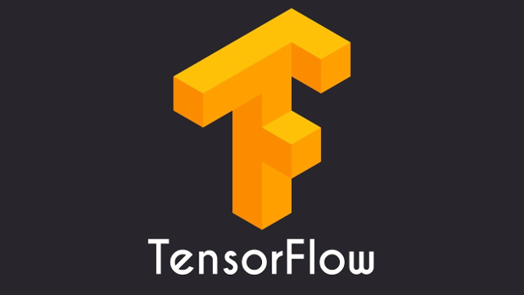

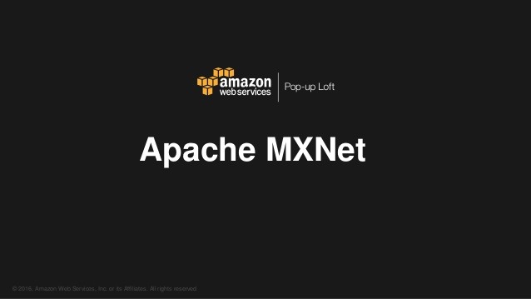
An Analytical Study of Major Deep Learning Framework’s & API
TF(imp frameworks) Keras mxnet gluon

Slide 2
Agenda:
Comparative Analysis of .
Tensorflow - Keras API
TensorFlow – Eager Execution API.
Tensorflow - Estimator API
MXNET – Gluon API
Keras
Metrics Used
Time Taken ( In Seconds)
Ease of Coding .

Slide 3
Execution Environment
Standardized Environment .
Google Collaboratory
MNIST – Hand Written Digit Recognition
Convolutional Neural Network
Python 3.7
Standardized Hyper Parameters
Standardized Activation and Optimization Function
Standardized Model

Slide 4
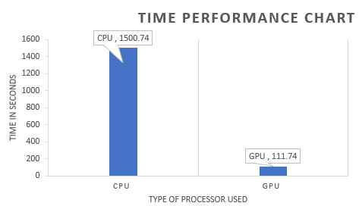
Tensorflow - Keras API
Model performed better in GPU driven Environment than CPU based environment as expected.
GPU based performance was 13 times better than CPU based performance
Coding the model took 11 lines of code.
Coding scale is 3 – Easy to use

Slide 5
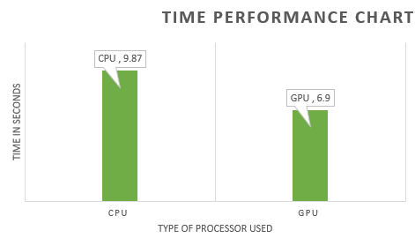
Tensorflow – ESTIMATOR API
Here GPU based performance was better than CPU
No remarkable difference in time taken although in large programs we may notice
Coding Heavy – 32 lines of code to implement same model
Code Scale- 1 .Low code friendly.

Slide 6
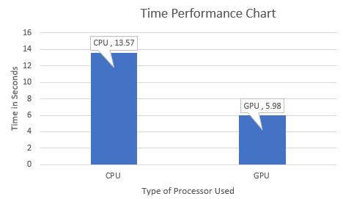
Tensorflow – EAGER Execution API
GPU based run performed the best and was also the best among all frameworks
CPU based run performance was more than GPU .
Eager Execution doesn’t build computational graph
Used for quick debugging
Coding Scale :2 , Normal Codability .

Slide 7
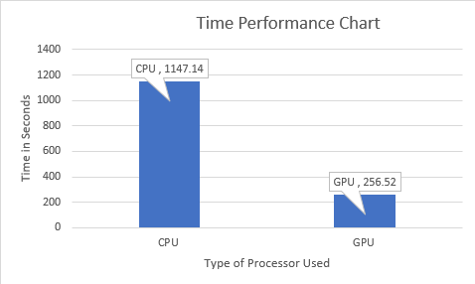
KERAS
The model took more time when running in CPU based Environment.
The Coding Scale 3 : Easy to Code
More use seen in academic environment .
Easy to learn and implement.

Slide 8
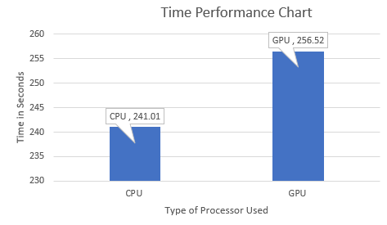
MXNET – Gluon API
Majorly used by AMAZON .
Works Best in AWS.
CPU performed better than GPU in TensorFlow.
The coding Scale -2 .Normal .

Slide 9
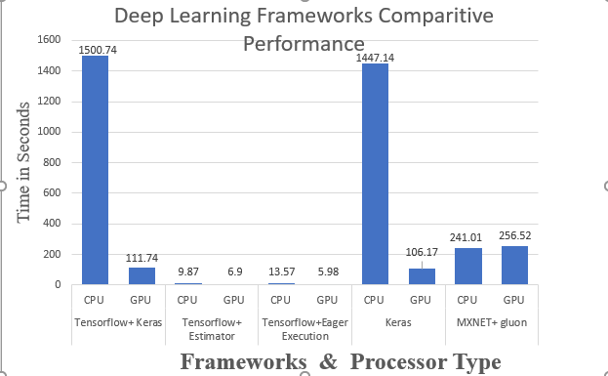
Comparative Analysis of TIME based PERFORMANCE

Slide 10
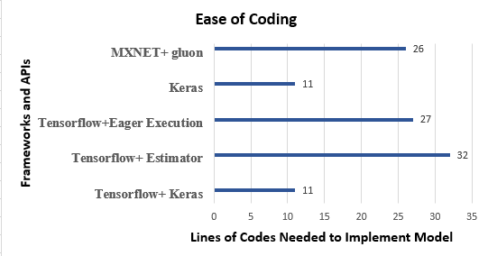
Comparative Analysis of CODE bASED PERFORMANCE

Slide 11
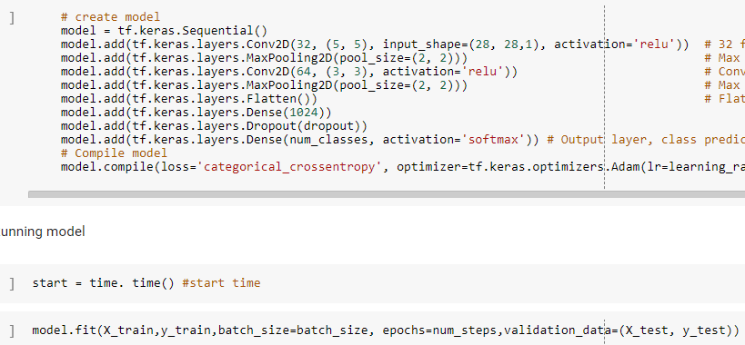
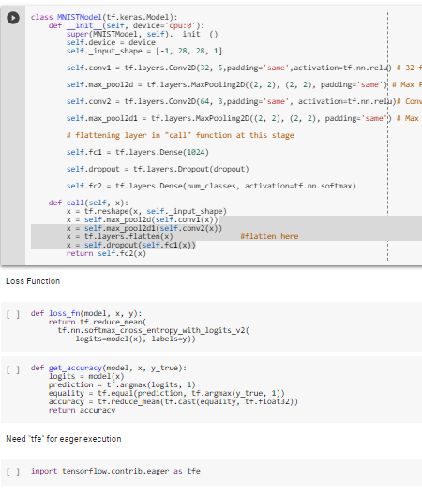
Snapshot comparison of the code:
TENSORFLOW KERAS
TENSORFLOW EAGER

Slide 12
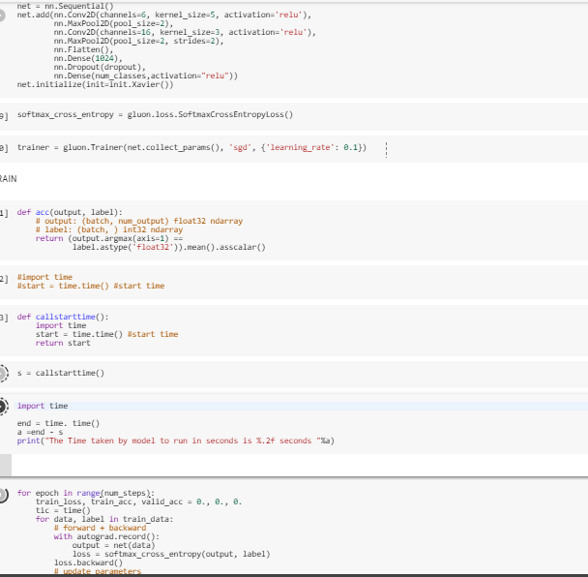
Snapshot comparison of the code:
TENSORFLOW KERAS
MXNET + GLUON

Slide 13
Conclusion
Keras is mostly used in academic purpose .
TF eager execution and estimator is more suitable for industry and production environment .
MXNET is best suited and supported in AWS cloud services.
MXNET performance decreases in Google environment.
Keras gives best coding experience & Eager give best execution time.

Slide 14

Thank You
Q&A?

